Slide 1
Transformer Model
Elza cherian

Slide 2
The Transformer
Proposed in the paper “Attention Is All You Need” Ashish Vaswani et al. 2017
Novel architecture that aims to solve sequence-to-sequence tasks while handling long-range dependencies with ease
Model that uses attention to boost the speed with which these models can be trained.
The Transformers outperforms the Google Neural Machine Translation model in specific tasks.
The biggest benefit is parallelization

Slide 3
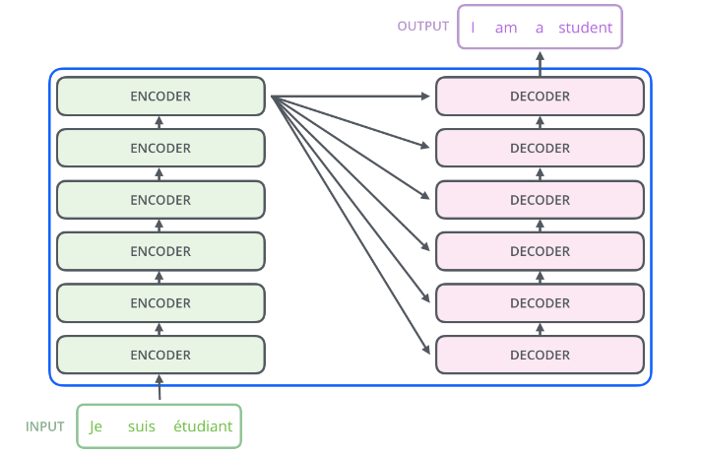
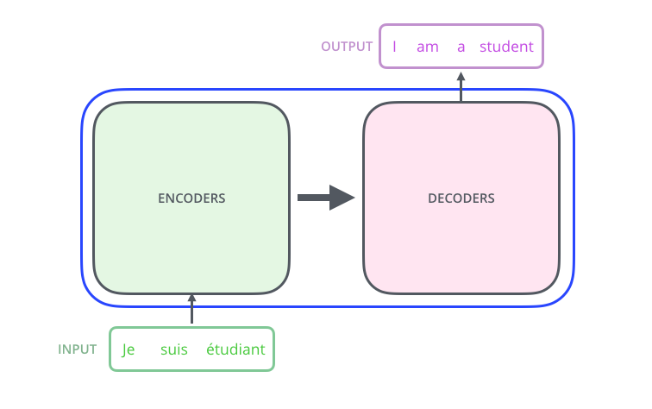
Architecture
Encoding component - stack of encoders ( six )
Decoding component - stack of decoders ( six )
Connections between them

Slide 4
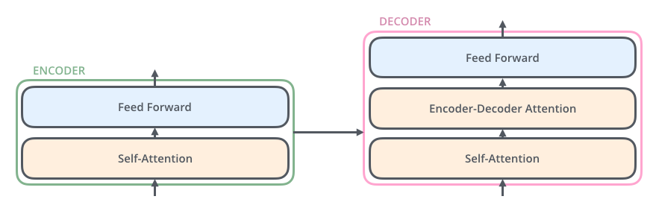
Encoder & Decoder
Encoders are all identical in structure
Each one is broken down into two sub-layers:
Encoder’s inputs first flow through a self-attention layer
Outputs of the self-attention layer are fed to a positionwise fully connected feed-forward network.
Decoder has both those layers

Slide 5

Input word
Turning each input word into a vector using an embedding algorithm.
The embedding only happens in the bottom-most encoder
Encoders receive list of vectors each of the size 512
Size of this list is hyperparameter – length of the longest sentence in our training dataset.
After embedding the words in our input sequence, each of them flows through each of the two layers of the encoder.

Slide 6
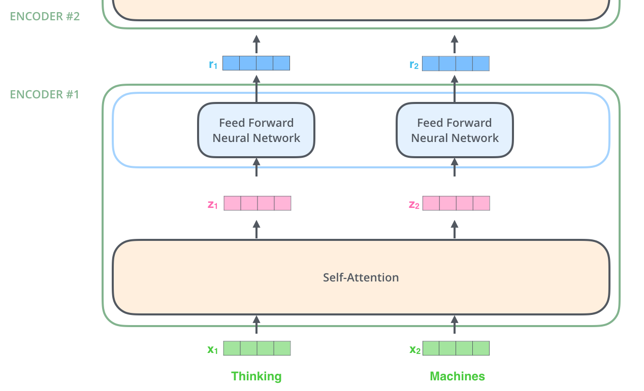
Self-attention
Key property of the Transformer
Word in each position flows through its own path in the encoder
There are dependencies between these paths in the self-attention layer
The feed-forward layer does not have those dependencies
Various paths can be executed in parallel while flowing through the feed-forward layer.

Slide 7
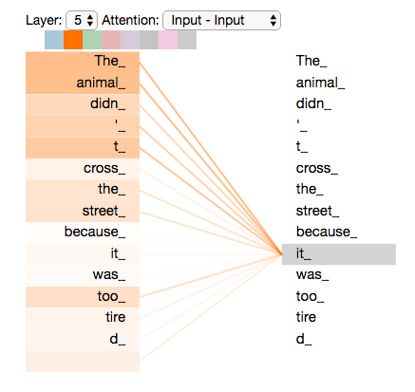
Self-Attention in Detail
Consider input sentence:
”The animal didn't cross the street because it was too tired”
Self-attention is the method the Transformer uses to bake the “understanding” of other relevant words into the one we’re currently processing

Slide 8
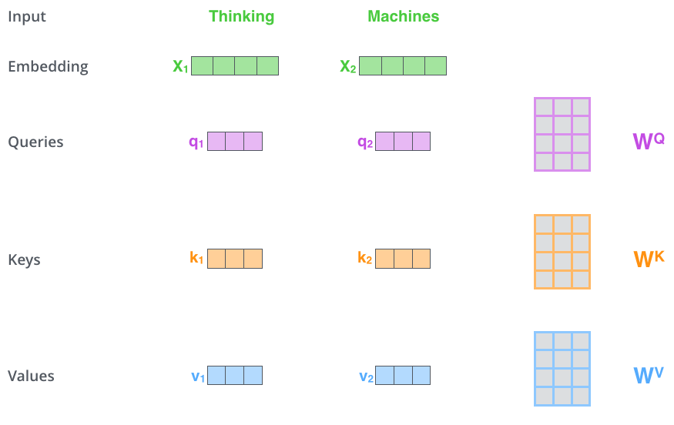
Calculating self-attention
First step
Create three vectors from each of the encoder’s input vectors (embedding of each word).
Query vector, a Key vector, and a Value vector.
Created by multiplying the embedding by three matrices that we trained during the training process.

Slide 9
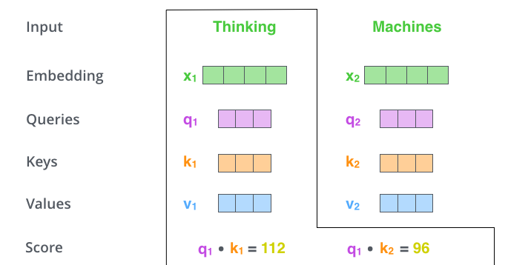
Calculating self-attention (contd)
Second step calculate a score
Score determines how much focus to place
Taking dot product of the query vector with the key vector of the respective word
Self-attention for the word in position #1
first score would be the dot product of q1 and k1.
The second score would be the dot product of q1 and k2.

Slide 10
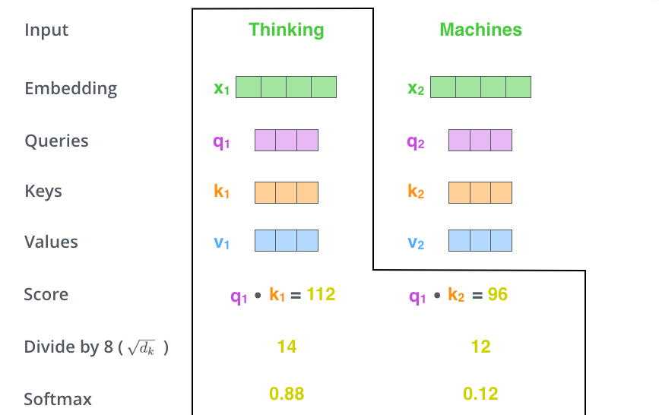
Calculating self-attention (contd)
Third and fourth steps
Divide the scores by 8 (square root of the dimension of the key vectors, 64)
Pass result through a softmax operation.
Softmax normalizes the scores so they’re all positive and add up to 1.
Softmax score determines how much each word will be expressed at this position

Slide 11
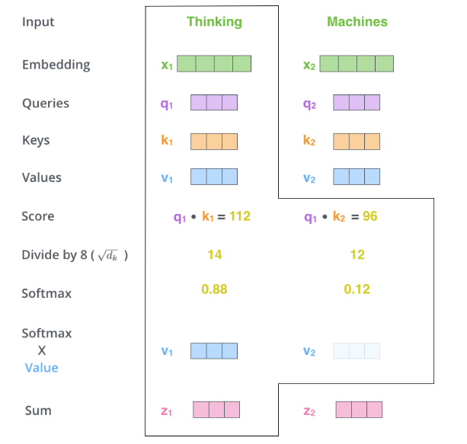
Calculating self-attention (contd)
The fifth step is to multiply each value vector by the softmax score
The sixth step is to sum up the weighted value vectors.
Resulting vector is one we can send along to the feed-forward neural network
Calculation is done in matrix form for faster processing

Slide 12
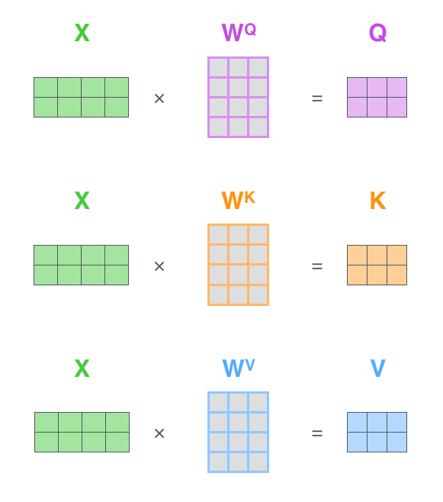
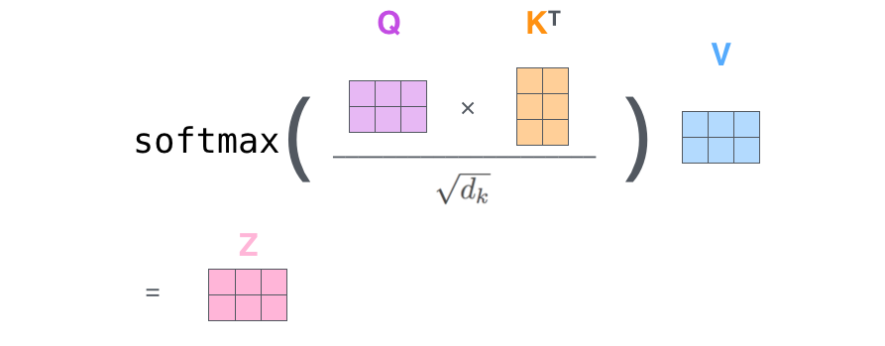
Matrix Calculation of Self-Attention
The first step is to calculate the Query, Key, and Value matrices.
Finally, condense steps two through six in one formula to calculate the outputs of the self-attention layer.

Slide 13
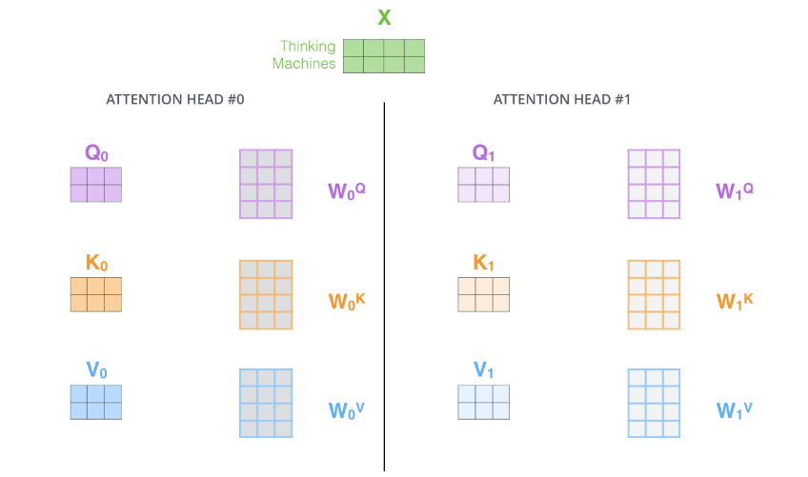
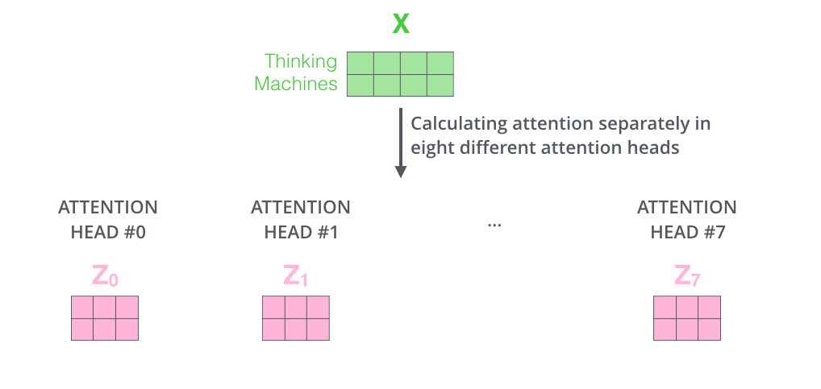
Multi-headed attention
Improves performance of the attention layer in two ways:
It expands the model’s ability to focus on different positions
It gives the attention layer multiple “representation subspaces”

Slide 14
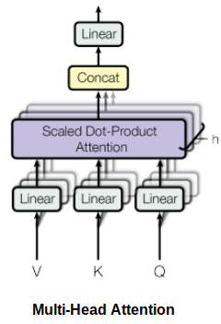
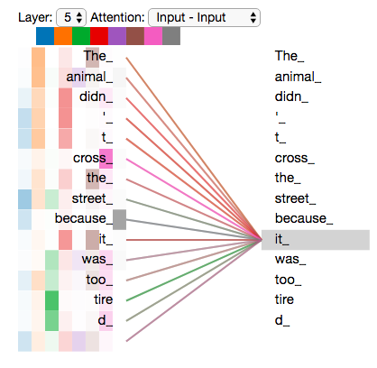

Slide 15
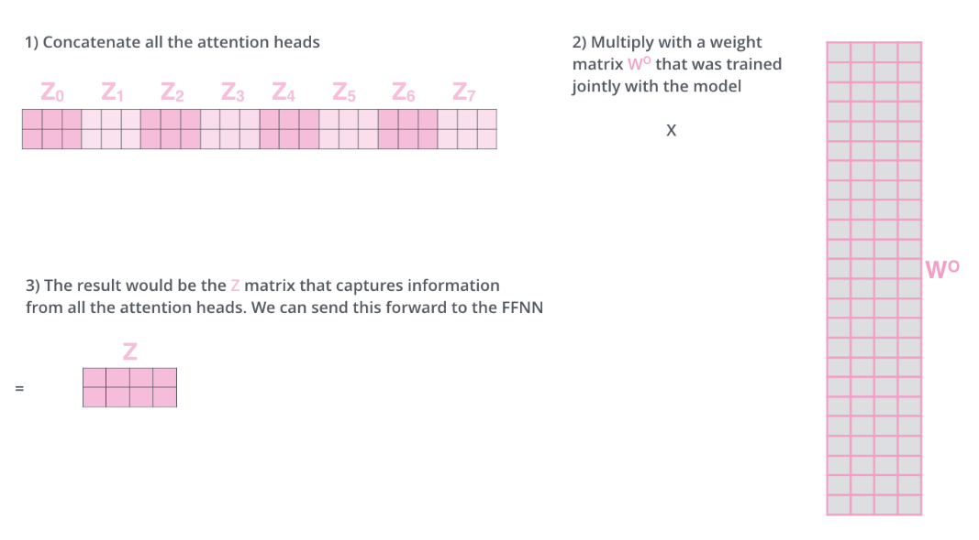
Concatenate matrices
Feed-forward layer expecting a single matrix (a vector for each word)
Concat the matrices then multiple them by an additional weights matrix WO.

Slide 16
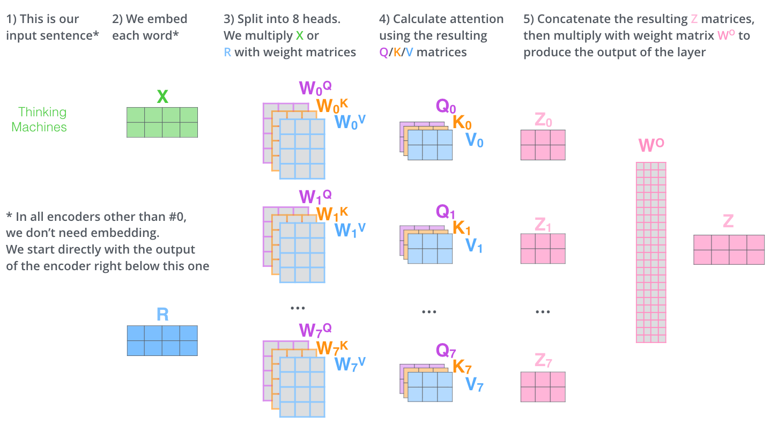

Slide 17
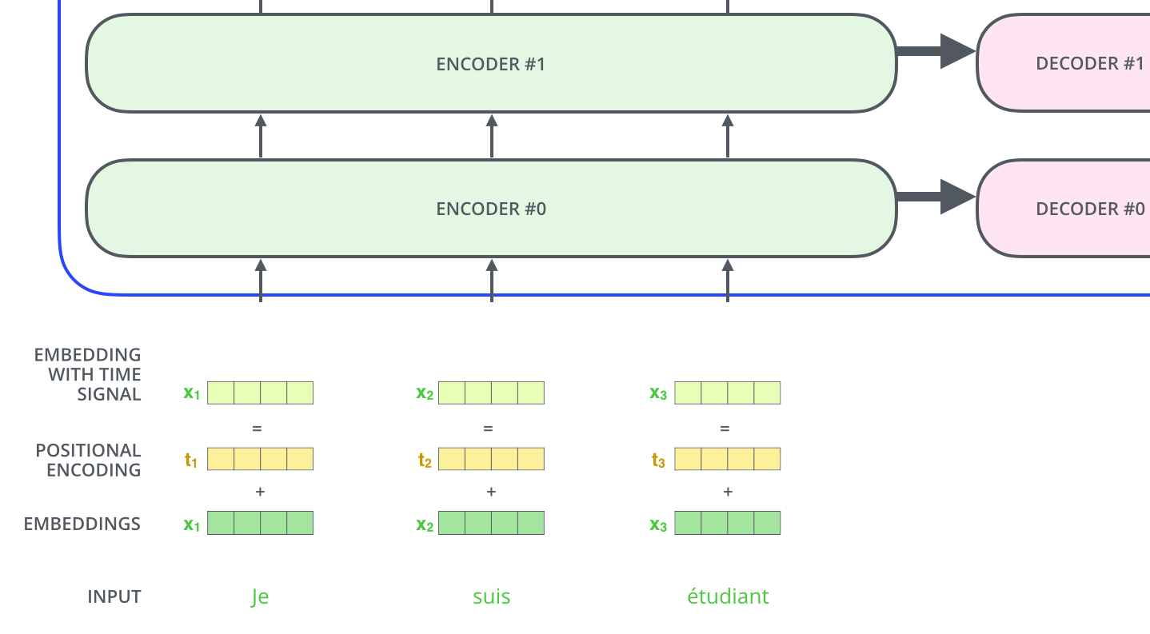
Positional Encoding
Order of the words in the input sequence.
Adds vector to each input embedding
Assume embedding has a dimensionality of 4

Slide 18
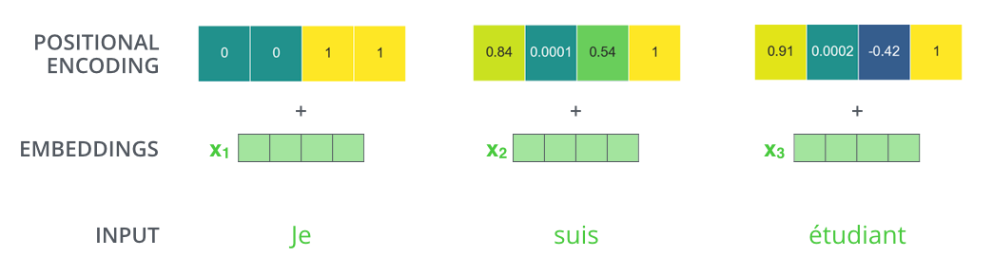
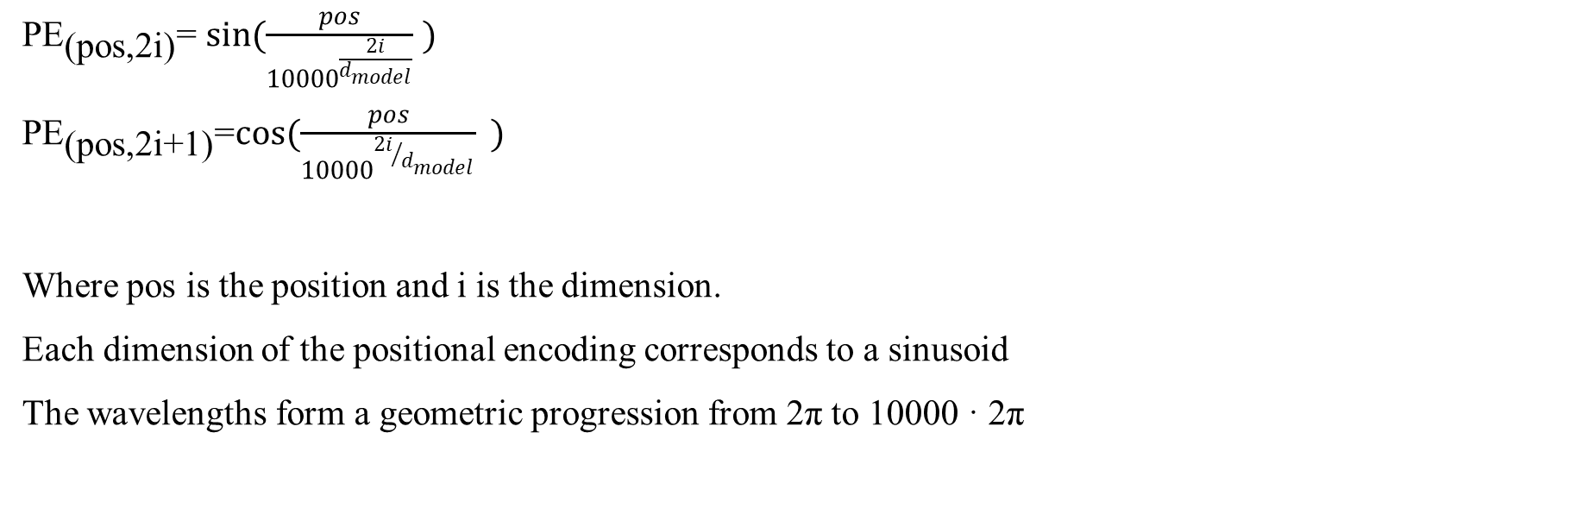
Positional Encoding formula
${\text{PE}}_{\text{(}\text{pos}\text{,2}\text{i}\text{)}}$= $\sin{(\frac{pos}{{10000}^{\frac{2i}{d_{model}}}} )}$
${\text{PE}}_{\text{(}\text{pos}\text{,2}\text{i}\text{+1}\text{)}}$=$\cos{(\frac{pos}{{10000}^{{2i}/{d_{model}}}}{ }}{)}$
Where pos is the position and i is the dimension.
Each dimension of the positional encoding corresponds to a sinusoid
The wavelengths form a geometric progression from 2π to 10000 · 2π

Slide 19
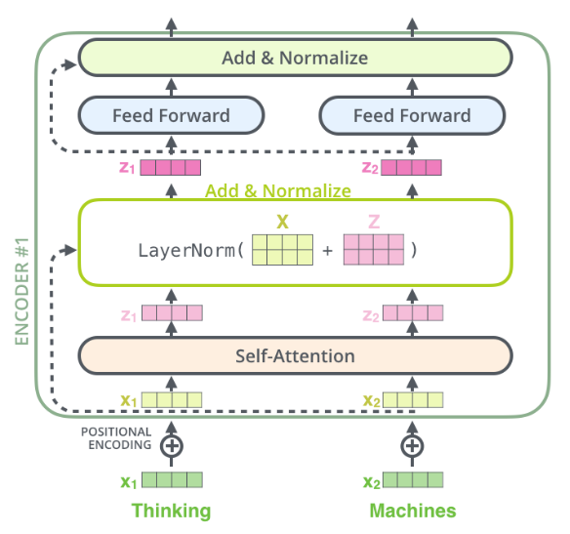
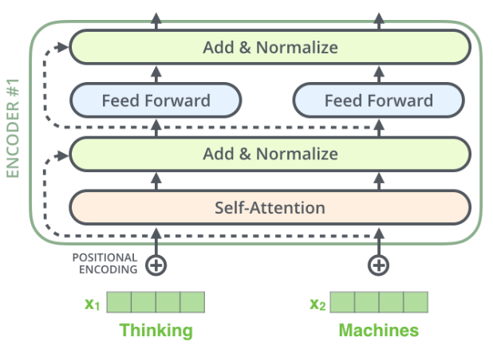
Residual
We employ a residual connection around each of the two sub-layers, followed by layer normalization. That is, the output of each sub-layer is LayerNorm(x + Sublayer(x)), where Sublayer(x) is the function implemented by the sub-layer itself.
To facilitate these residual connections, all sub-layers in the model, as well as the embedding layers, produce outputs of dimension dmodel = 512
Vectors and the layer-norm operation associated with self attention

Slide 20
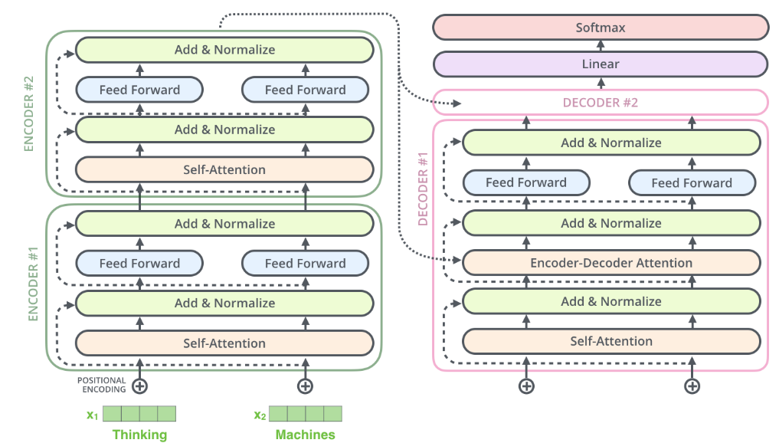

Slide 21
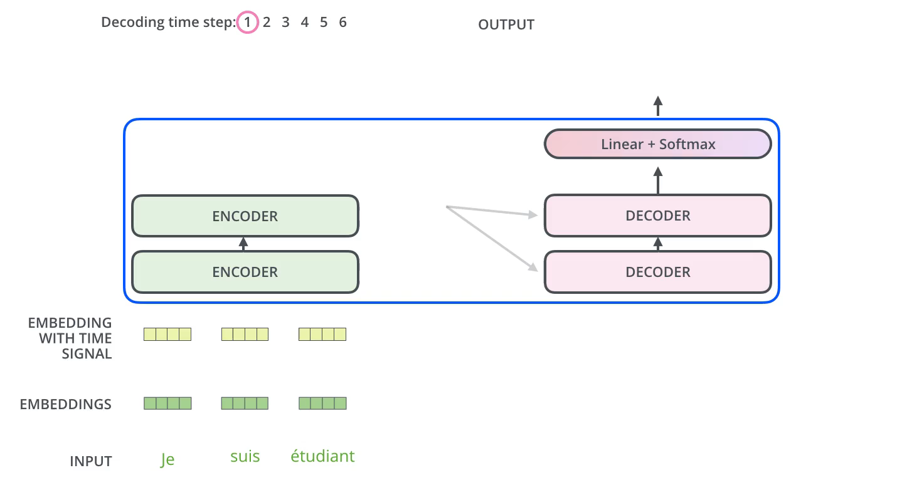
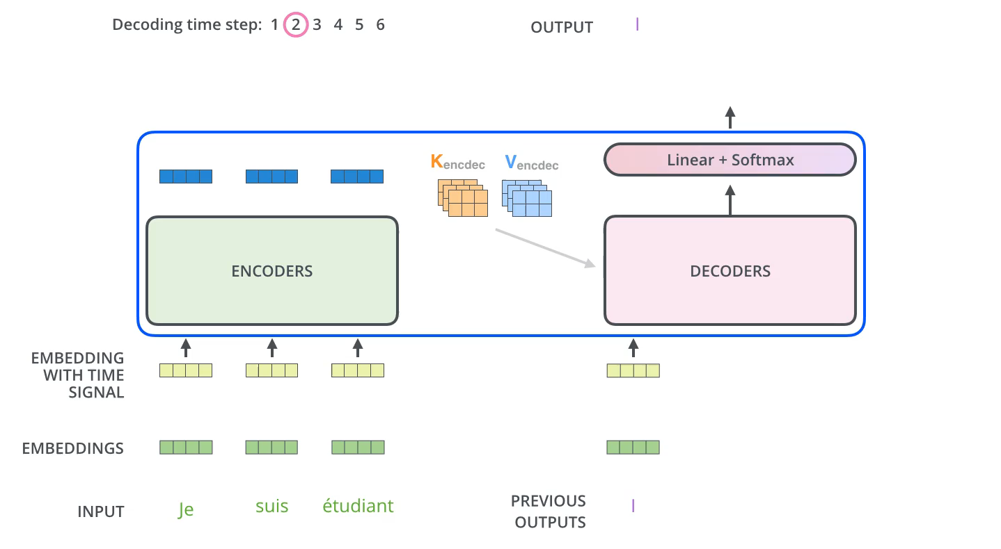
The Decoder Side

Slide 22
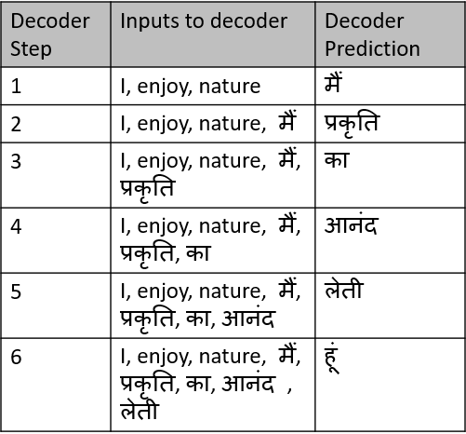
Decoder example

Slide 23
Padding and Masking
Prior to the softmax function, apply a mask to the attention score.
Mask will be either a padding mask or a combination of the padding mask and a look-ahead mask.
The sequences that are the input to the encoder and the decoder must be of the same length.
Because sentences are of varying length, one must either truncate the sentence or pad the sentence so that they are all of a specified length.
As a result, the padding might be interpreted as meaningful by the attention mechanism leading to unreliable learning.

Slide 24
To mitigate this effect, a padding mask is applied so that when added to the attention scores, the values in the padded positions become so small as to be ignored.
This is achieved by setting the positions in the mask to a value close to negative infinity.
Transformers are autoregressive models.
They look at all of the previous input in a sequence in order to predict the next output (token).
Needs to be a way to limit attention for any position so that only the portion of the sequence that comes before it is attended to. This is because it is desired that the model infers the next position without having a peak. If it were able to look at the next position, then it would just copy it.
All of the attention scores for words that occur to the right of a query word in the sequence are masked. This limits the query word to attend to itself and all words to the left in the sequence.

Slide 25
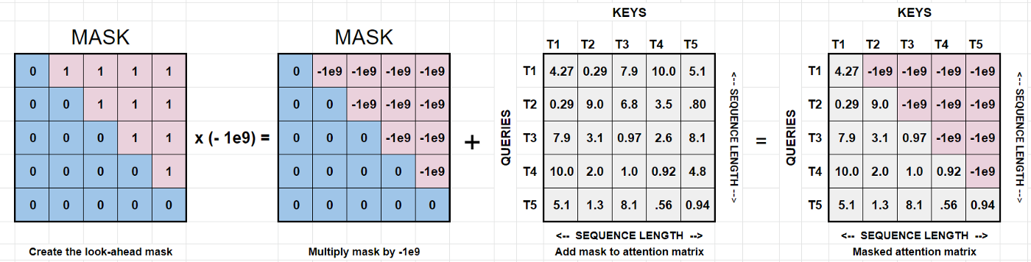
The look-ahead mask is only applied to the first Attention sub-layer of each decoder layer. That’s because the decoder is where the inferencing occurs. Therefore, that is where the model should not be able to peek ahead.
1. Create a mask where the values for the upper right triangle above the diagonal are all ones and the rest zeros.
2. Multiply the mask by -1e9.
3. Add the mask to the attention matrix.

Slide 26
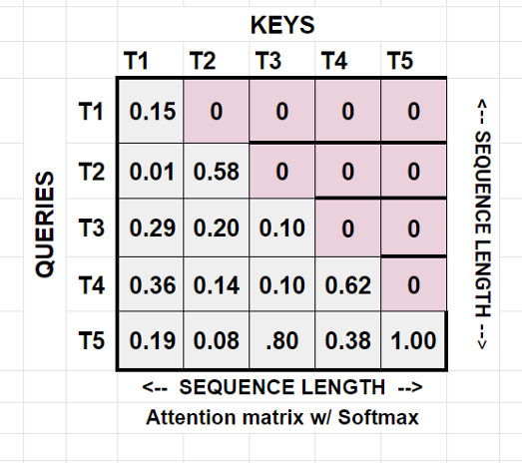
Next, apply the softmax along the key columns, converting those values to probability distributions. After applying softmax to the attention matrix, all of those extremely small values will become zero.
In the toy attention matrix in the figure, I’ve labeled both axes [T1,…,Tn]. The columns represent the token (word) keys and the rows are the token queries. The attention score for any, query Ti, are the values in its row with respect to the key columns [T1,…,Tn]. Notice that the topmost query, T1 can only get the score for the leftmost key T1. There is no meaningful information for T2,...,T5 (values too low). The query T2 has access to the set of keys [T2, $T1]. And so on, until the last word, T5, which has access to the entire sequence.
So next, the dot product between the attention weight matrix and the value matrix is calculated. This has the effect of applying the weights to the values. If you are following along, you’ll notice that the values in the T1 embeddings are only affected by the T1 attention weights in row 1. The T2 embeddings only affected the attention weights in row 2, T1 and T2. And so it goes until you reach the final embedding (last word in sequence) whose embeddings are affected by all the weights in the final row. That’s how autoregression is achieved.
This figure shows that which was just described.

Slide 27
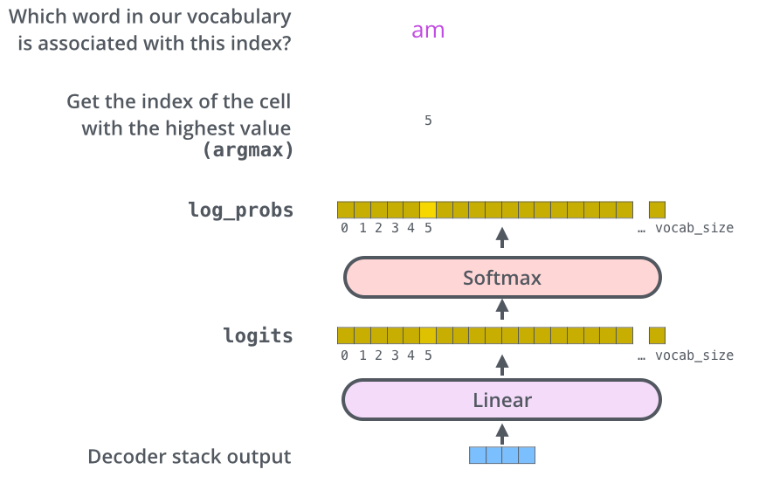
The Final Linear and Softmax Layer
Linear layer is a simple fully connected neural network that projects the vector produced by the stack of decoders, into a much, much larger vector called a logits vector.
The softmax layer then turns those scores into probabilities (all positive, all add up to 1.0)
Cell with the highest probability is chosen, and the word associated with it is produced as the output for this time step.

Slide 28
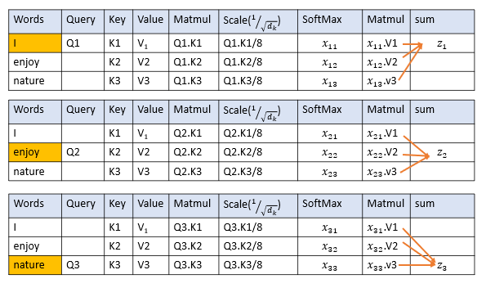
Recap Of Training
Softmax normalizes the scaled value.
After applying Softmax, all the values are positive and add up to
Next, you take the softmax of the scaled score to get the attention weights, which gives you probability values between 0 and 1. By doing a softmax the higher scores get heighten, and lower scores are depressed. This allows the model to be more confident about which words to attend too.

Slide 29
Features of Transformers
The drawbacks of the seq2seq model are addressed by Transformer
Parallelizing Computation
Reduced number of operations
Long-range dependencies
Limitations:
Attention can only deal with fixed-length text
Chunking of text causes context fragmentation

Slide 30
https://is-rajapaksha.medium.com/bert-word-embeddings-deep-dive-32f6214f02bf
https://medium.com/@phylypo/a-survey-of-the-state-of-the-art-language-models-up-to-early-2020-aba824302c6
https://medium.com/analytics-vidhya/understanding-attention-in-transformers-models-57bada0cce3e
https://towardsdatascience.com/transformers-explained-visually-part-3-multi-head-attention-deep-dive-1c1ff1024853
https://jalammar.github.io/illustrated-transformer/
https://github.com/logpai/awesome-log-analysis/blob/master/papers.md

